Slide 1
Session 3
Introduction to SOAP

Slide 2
Session Objectives
Discuss the need for a protocol
Explain the relation between HTTP and XML
Explain the concept of SOAP protocols
Describe the working of SOAP messages
Explain the architecture of SOAP messages
Identify and analyze the different parts of a SOAP message
Discuss the merits and limitations of SOAP

Slide 3




Communication Rules
FILE
Data Packets
File being transferred from A to B in DATA PACKETS
Computer A
Computer B
No acknowledgement is sent back from B to A
A continues to send the data packets even if B has a hardware failure
Packets transmitted during this time are lost
Next packet should be sent only if acknowledgement for the previous is received
The rules for communication are know as Protocols

Slide 4
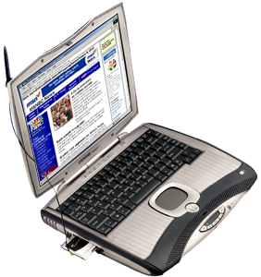
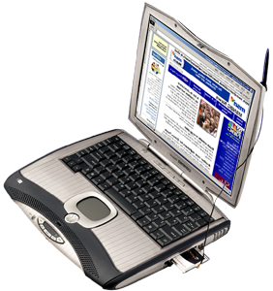
TCP/IP and HTTP
Fundamental protocol used for communication over a computer network
Communicate using TCP/IP
Identified by IP addresses
10.1.2.1
10.1.2.6
HTTP sits over TCP/IP protocol
HTTP was designed for the web for transmission of HTML pages

Slide 5
XML and HTTP
XML is a text based markup language
XML can be used with HTTP to communicate data between
applications working on different platforms
XML
HTTP
TCP/IP

Slide 6
Simple Object Access Protocol
Application A
Component A
SOAP
HTTP
Component B
Application B
Component C
XML based , light weight protocol used with HTTP for communication

Slide 7
Working of SOAP
2
Network
SOAP Client
SOAP Server
2
3
Request
Document
HTTP
Packet
6
4
1
HTTP
Packet
Response
Document
5

Slide 8
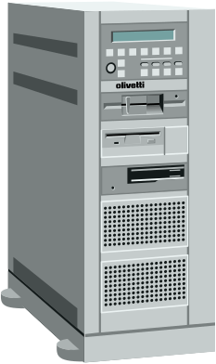
An Example of SOAP
SOAP
Processor
HTTP
XML
Parser
API
Response
Request
API
SOAP
Processor
HTTP
Client command creates action on application server
XML
Parser
Result sent to the client that had called the Web Service

Slide 9
Architecture of SOAP Messages
SOAP message with
an HTTP packet
SOAP header is optional
Delivery
Information
Header
ENVELOPE
PayLoad
Body
HTTP Packet

Slide 10
SOAP Terminology
SOAP Envelope: This is the root element in a SOAP message. Is
wrapped in a transport protocol packet like HTTP. It is XML
encoded and is mandatory in a SOAP message
SOAP Header: Optional. Contains header information
SOAP Body: Consists of the tags defined by the method to be
invoked

Slide 11
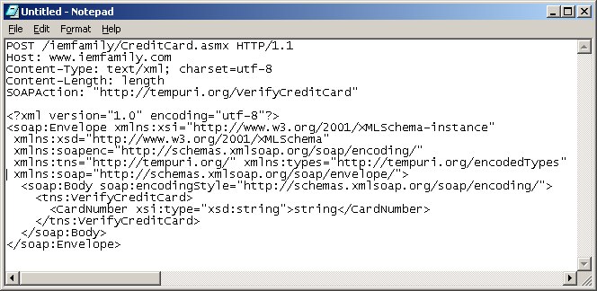

SOAP Request Using HTTP
HTTP header
SOAP body enclosed in SOAP envelope

Slide 12
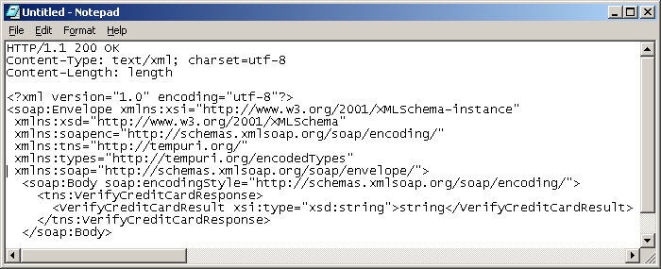
SOAP Response Using HTTP
HTTP header
SOAP body enclosed in SOAP envelope

Slide 13
SOAP Message
HTTP Header
Object Endpoint ID and method identifier
SOAP Envelope
Namespaces for version
and encoding
SOAP Header
Name, namespace, actor
Element, namespaces
SOAP Body
Name, namespace, actor
Element, namespaces

Slide 14
HTTP Header
HTTP
method used
Target file
HTTP version specification
Post /iemfamily/CreditCard.asmx HTTP/1.1
Host: www.iemfamily.com
Content-Type: text/xml; charset=utf-8
Content-Length: length
Target URL
This is a place holder and holds the length of the document
Encoding used

Slide 15
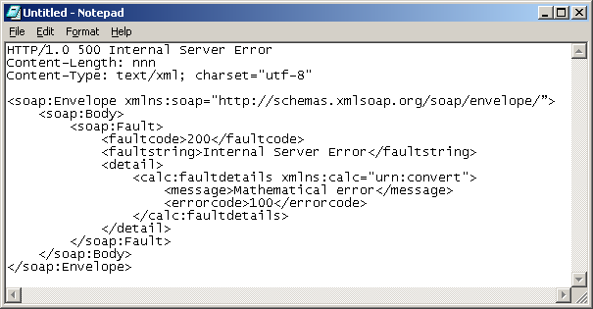
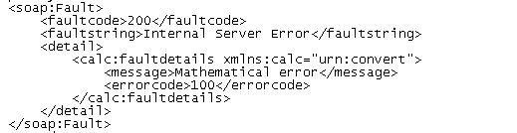
Fault Element
Used to transport error, status information
Presence is optional
Must be a body entry, can appear only once
Has four child elements

Slide 16
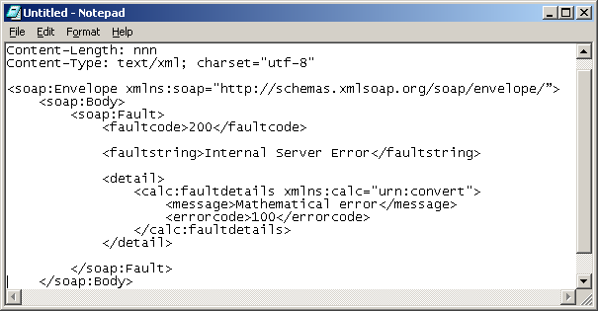
Fault: Child Elements
faultcode: Used by web service consumer to
identify the fault
faultstring: Used to provide description of
the fault
faultactor: Used to identify the source of
the fault
detail: Holds application specific error
information

Slide 17

Merits of SOAP
MERITS
Built upon open technologies like HTTP and XML. This facilitates
interoperability between applications
Not bound with any transport protocol. Hence flexible
Works with any application that accesses port 80 for HTTP requests
and responses
Encourages distributed computing
Changes in SOAP specification will not cause major changes
in applications

Slide 18
Demerits of SOAP
DEMERITS
Simply a wire protocol and not a complete distributed architecture
Does not account for security in distributed computing environment
Remote garbage collection not supported
Storing the state of a remote object not supported if HTTP is used
as underlying protocol
Performance is poor as compared to other contemporary wire
protocols

